Slide 1
ACM算法与程序设计
第四讲
广度优先（BFS）搜索
数学科学学院：汪小平
wxiaoping325@163.com

Slide 2
第十一届电子科技大学程序设计竞赛暨西南地区高校邀请赛
参赛条件：每支参赛队伍可由1~3名学生组成，所有电子科技大学在读学生（包括本科生和研究生）均可组队参赛。
参赛语言：C/C++、Java。
报名方式：登陆电子科技大学在线评测系统（http://acm.uestc.edu.cn/upc11.php）即可报名。
比赛日程：
3月23号 ：12:30-17:30 第一场热身赛
3月28号 ：09:00-21:00 第二场热身赛
3月30号 ：校赛初赛
4月06号 ：校赛现场决赛

Slide 3
第十一届电子科技大学程序设计竞赛暨西南地区高校邀请赛
比赛形式：热身赛和初赛采用的是网络赛，比赛采用的平台是电子科技大学在线评测系统（http://acm.uestc.edu.cn）。决赛的形式是现场赛，将完全采用ACM国际大学生程序设计竞赛的赛制。
报名截止时间：2013年3月29日21:00 （热身赛无须报名）
技术讲座：2013年3月21号 ：校赛前讲座（时间：下午七、八节，地点：清水河基础教学楼A204）
在比赛过程中需遵守以下条款：
1、在比赛过程中，不得与除队友以外的其他人进行有关比赛的任何交流。
2、在比赛过程中，不得索要和使用其他队伍的代码。
3、在比赛过程中，不得试图做出对评测系统进行攻击等的危害比赛正常进行的举动。
如有任何疑问，请致信组委会：acm@uestc.edu.cn

Slide 4
广度优先搜索算法（Breadth -First-Search）
也被作宽度优先搜索，或横向优先搜索，简称BFS。BFS是从根节点开始，沿着树的宽度遍历树的节点。如果所有节点均被访问，则算法中止。（稳扎稳打，步步推进）
广度优先搜索的实现一般采用队列。所有因为展开节点而得到的子节点都会被加进一个先进先出的队列中。
因为所有节点都必须被储存，因此BFS的空间复杂度为 O(|V| ，其中 |V| 是节点的数目。由于对空间的大量需求，因此BFS并不适合解非常大的问题。
最差情形下，BFS必须寻找所有到可能节点的所有路径，因此其时间复杂度为 O(|V| + |E|)，其中 |V| 是节点的数目，而 |E| 是图中边的数目。

Slide 5
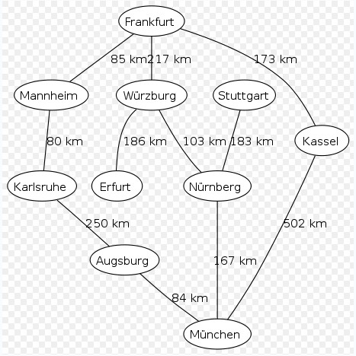
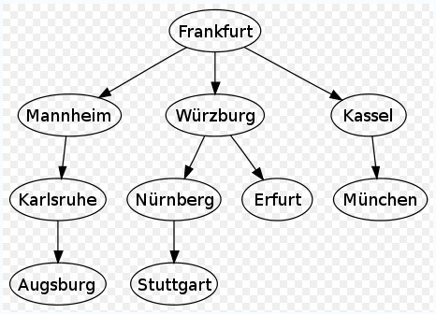
从法兰克福开始执行广度优先搜索算法，所产生的广度优先搜索算法树。
以德国城市为范例的地图，
城市间有数条道路相连接。

Slide 6
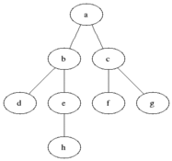
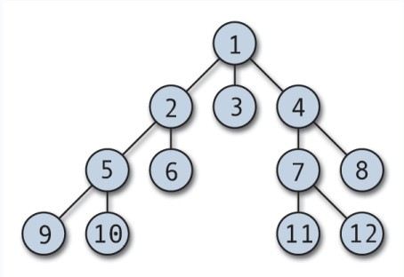
1、首先将根节点放入队列中。
2、从队列中取出第一个节点，并检验它是否为目标。
如果找到目标，则结束搜寻并回传结果。
否则将它所有尚未检验过的直接子节点加入队列中。
3、若队列为空，表示整张图都检查过了——亦即图中没有欲搜寻的目标。结束搜寻并回传“找不到目标”。
4、重复步骤2。

Slide 7
算法：
void BFS(VLink G[], int v)
{ int w;
VISIT(v); /*访问顶点v*/
visited[v] = 1; /*顶点v对应的访问标记置为1*/
ADDQ(Q,v);
while(!QMPTYQ(Q))
{ v = DELQ(Q); /*退出队头元素v*/
w = FIRSTADJ(G,v); /*求v的第1个邻接点。无邻接点则返回-1*/
while(w != -1)
{ if(visited[w] == 0)/*未检验过*/
{ VISIT(w); /*访问顶点v*/
ADDQ(Q,w); /*当前被访问的顶点w进队*/
visited[w] = 1; /*顶点w对应的访问标记置为1*/
}
W = NEXTADJ(G,v); /*求v的下一个邻接点。若无邻接点则返回-1*/
}
}
}

Slide 8
总结BFS的思路就是第N步就把N步所能达到的所有状态都找出来。当然这样子是有代价的，那就是可能需要比DFS多很多的空间。不过BFS的优势在于它能够很快的找到最优解。BFS和DFS一样都是很暴力的算法，因为它们都属于盲目搜索算法。

Slide 9
Find The Multiple http://poj.org/problem?id=1426
Description
Given a positive integer n, write a program to find out a nonzero multiple m of n whose decimal representation contains only the digits 0 and 1. You may assume that n is not greater than 200 and there is a corresponding m containing no more than 100 decimal digits.

Slide 10
Input
The input file may contain multiple test cases. Each line contains a value of n (1 <= n <= 200). A line containing a zero terminates the input.
Output
For each value of n in the input print a line containing the corresponding value of m. The decimal representation of m must not contain more than 100 digits. If there are multiple solutions for a given value of n, any one of them is acceptable.

Slide 11
Sample Input
2
6
19
0
Sample Output
10
100100100100100100
111111111111111111

Slide 12
这等同于构造一颗二叉树，然后按层次去遍历这颗树；
1
10
11
100
101
110
111
…
……

Slide 13
#include<iostream>
using namespace std;
int n;
long long q[9999999];
int main()
{
while(scanf("%d",&n)&&n)
{
BFS();
}
return 0;
}

Slide 14
void BFS()
{
int front,rear;
front=rear=0;
q[rear++]=1;
long long top;
while(rear>front)
{
top = q[front++];
if( top%n==0 )
break;
top *= 10;
q[rear++]=top;
q[rear++]=top+1;
}
printf("%lld\n",top);
}

Slide 15
Prime Path http://poj.org/problem?id=3126
Description
The ministers of the cabinet were quite upset by the message from the Chief of Security stating that they would all have to change the four-digit room numbers on their offices.
— It is a matter of security to change such things every now and then, to keep the enemy in the dark.
— But look, I have chosen my number 1033 for good reasons. I am the Prime minister, you know!
— I know, so therefore your new number 8179 is also a prime. You will just have to paste four new digits over the four old ones on your office door.
— No, it’s not that simple. Suppose that I change the first digit to an 8, then the number will read 8033 which is not a prime!
— I see, being the prime minister you cannot stand having a non-prime number on your door even for a few seconds.
— Correct! So I must invent a scheme for going from 1033 to 8179 by a path of prime numbers where only one digit is changed from one prime to the next prime

Slide 16
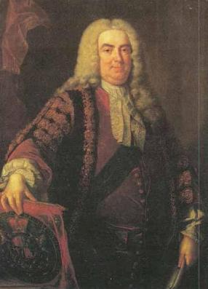
Now, the minister of finance, who had been eavesdropping, intervened.
— No unnecessary expenditure, please! I happen to know that the price of a digit is one pound.
— Hmm, in that case I need a computer program to minimize the cost. You don't know some very cheap software gurus, do you?
— In fact, I do. You see, there is this programming contest going on... Help the prime minister to find the cheapest prime path between any two given four-digit primes! The first digit must be nonzero, of course. Here is a solution in the case above.
1033
1733
3733
3739
3779
8779
8179
The cost of this solution is 6 pounds. Note that the digit 1 which got pasted over in step 2 can not be reused in the last step – a new 1 must be purchased.

Slide 17
Input
One line with a positive number: the number of test cases (at most 100). Then for each test case, one line with two numbers separated by a blank. Both numbers are four-digit primes (without leading zeros).
Output
One line for each case, either with a number stating the minimal cost or containing the word Impossible.

Slide 18
Sample Input
3
1033 8179
1373 8017
1033 1033
Sample Output
6
7
0

Slide 19
首先区分the prime minister 和prime number中的prime的不同意思。
从起始素数开始进行广搜，每轮将所有可行的改变（个位至千位，每个位置进行一次改变）放入搜寻队列一次进行素数判断。
用数组来记载转变路径，每个结点指向其父结点。达到目标之后向上寻找到先人，即可求出转变了多少次 。

Slide 20
STL：queue
#include<queue>
定义一个queue的变量： queue<Type> M
查看是否为空队列：M.empty() 是的话返回1，不是返回0;
从已有元素后面增加元素：M.push()
输出现有元素的个数：M.size()
显示第一个元素：M.front()
显示最后一个元素：M.back()
清除第一个元素：M.pop()

Slide 21
#include <iostream>
#include <queue>
#include <math.h> //或者 #include <cmath>
using namespace std;
int a, b;
int p[9999] = { 0 };
int visited[9999] = { 0 };
bool isprime(int x)
{
for (int i = 2; i <= sqrt((double) x); ++i)
{
if (x % i == 0)
return false;
}
return true;
}

Slide 22
int BFS(int s, int r)
{
queue<int> q;
q.push(s);
p[s] = 0; //距起点距离
visited[s] = 1; //访问标志
while (!q.empty())
{
int temp = q.front();
q.pop();
for (int i = 0; i <= 9; i++)
{
int y1 = (temp / 10) * 10 + i; //改变个位
if (isprime(y1) && !visited[y1])
{
q.push(y1);
p[y1] = p[temp] + 1; //距离增1
visited[y1] = 1;
}

Slide 23
int y2 = temp % 10 + (temp / 100) * 100 + i * 10; //改变十位
if (isprime(y2) && !visited[y2])
{
q.push(y2);
p[y2] = p[temp] + 1;
visited[y2] = 1;
}
int y3 = temp % 100 + (temp / 1000) * 1000 + 100 * i; //改变千位
if (isprime(y3) && !visited[y3])
{
q.push(y3);
p[y3] = p[temp] + 1;
visited[y3] = 1;
}

Slide 24
if (i != 0)
{
int y4 = temp % 1000 + i * 1000;
if (isprime(y4) && !visited[y4])
{
q.push(y4);
p[y4] = p[temp] + 1;
visited[y4] = 1;
}
}
if (visited[r])
return p[r];
}//end for
}//end while
return 0;
}

Slide 25
int main()
{
int n;
scanf ("%d",&n);
while (n--)
{
memset(visited,0,sizeof(visited));
memset(p,0,sizeof(p));
scanf ("%d %d",&a,&b);
printf("%d\n", BFS(a, b));
}
return 0;
}

Slide 26
Erdos Number http://acm.uestc.edu.cn/problem.php?pid=1154
Description
Paul Erdos(1913-1996) is a legendary mathematician of the 20th century. Famous for his eccentric living style, Erdos was one of the most prolific publishers of papers in mathematical history, having written around 1500 mathematical articles, mostly with co-authors. Erdos spent most of his lifetime traveling between scientific conferences and visiting homes of colleagues all over the world, with most of his belongings in a suitcase. He would typically show up at a colleague's doorstep and announce "my brain is open", staying long enough to collaborate on a few papers before moving on a few days later.
In many cases, he would ask the current collaborator whom he should visit next. Because of his prolific output, friends created the Erdos number as a humorous tribute, which has been a part of the folklore of mathematicians throughout the world for many years. Erdos himself is assigned the Erdos number of 0.

Slide 27
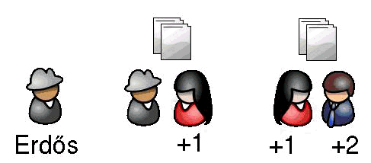
Those who have co-written a paper with Erdos have an Erdos number of 1. In turn, authors who have collaborated with those whose Erdos number is 1(but not with Erdos himself) have an Erdos number of 2. In general, if the lowest Erdos number of the cowriters of an author is S, then his Erdos number is S + 1. A person with no such coauthorship chain connecting to Erdos has an infinite Erdos number.
For example, in the picture above, the lady collaborates with Erdos on one paper, and then with the man on the right on another, so this man is given an Erdos number of 2(assuming he has never collaborated with Erdos himself).

Slide 28
The interesting thing with Erdos number is that about 90% of the world's active mathematicians have an Erdos number smaller than 8, and many mathematicians have an Erdos number surprisingly smaller than they expect. For example, Andrew Wiles, who have proved the Fermat's Last Theorem and whose research area is very different from that of Erdos, has an Erdos number of only 3. All Fields prize winners have an Erdos number at most 5 and all Wolf prize winners' Erdos numbers do not exceed 6. In addition, a very large number of non-mathematicians also have finite Erdos numbers. For example, Albert Einstein has an Erdos number of 2 and Bill Gates has an Erdos number of 4.
Your task is, given a list of co-writing activities of authors, to answer a series of queries according to the list, which have the form: "What is the Erdos number of author A?"

Slide 29
Input
The first line of the input file is an integer N, number of co-authoring activities. The next N lines each contain two names, separated with spaces, meaning these two authors have co-written a paper. On the next line is an integer M, number of queries. The next M lines each contain the name of an author.
Constraints
N ≤ 50000, M ≤ 50000

Slide 30
Notes
Names contain letters('A'-'Z', 'a'-'z') and '.' only and don't contain white spaces.
Each name has at most 20 characters.
Names are case-sensitive, e.g. Erdos is not the same person as erdos.
Authors with the same name should be considered the same person.
Paul Erdos himself is represented with exactly the name "Erdos".
The same co-authoring activity is listed at most once.
No author will be co-authoring with himself.

Slide 31
Output
For each query, output the corresponding author's Erdos number on a line. If the author doesn't have a finite Erdos number, output "infinity" instead(quotes for clarity only).

Slide 32
Sample Input
7
Erdos Andrew.Odlyzko
Andrew.Odlyzko Chris.M.Skinner
Chris.M.Skinner Andrew.Wiles
Erdos Pavol.Hell
Pavol.Hell Xiao.Tie.Deng
Xiao.Tie.Deng Chris.Papadimitriou
Chris.Papadimitriou Bill.Gates
3
Andrew.Wiles
Bill.Gates
Albert.Einstein
Sample Output
3
4
infinity

Slide 33
以Erdos为起始点直接BFS扩展一棵宽度优先树，两个节点有边当且仅当这两个作者合作。
每个节点在树中到Erdos的距离就是它的Erdos数。
陷阱：输入的合作关系里边可能没有Erdos这个人，但是查询中可能会有Erdos，这时应当输出0而不是infinity。

Slide 34
为了迅速的找到Erdos，可构造经典的字符串Hash函数实现。
unsigned ELFhash(const char *key)
{
unsigned h = 0;
while (*key != '\0')
{
h = (h << 4) + *key++;
unsigned g = h & 0xf0000000;
if (g)
h ^= g >> 24;
h &= ~g;
}
return h % HASH_SCALE;
}

Slide 35
#include <list>
#include <queue>
#include <iostream>
const unsigned MAX_LEN = 20;
const unsigned HASH_SCALE = 400000;
struct Node
{
char name[MAX_LEN + 1];
int dist;
Node *next; //记录冲突结点
std::list<Node*> neib;//记录合作者结点
Node(const char _name[], Node *_next):dist(-1), next(_next)
{
strcpy(name, _name);
}
};

Slide 36
Node* hashTable[HASH_SCALE];
unsigned ELFhash(const char *key)
{
unsigned h = 0;
while (*key != '\0') {
h = (h << 4) + *key++;
unsigned g = h & 0xf0000000;
if (g)
h ^= g >> 24;
h &= ~g;
}
return h % HASH_SCALE;
}
Node* enhash(const char name[])
{
unsigned h = ELFhash(name);
Node *p = hashTable[h];
while (p != NULL && strcmp(p->name, name) != 0)
p = p->next; //冲突处理，检查是否有相同名字
return p ? p : hashTable[h] = new Node(name, hashTable[h]);
}

Slide 37
void get_coauthor_activities()
{ //读取数据，添加合作者
int N;
scanf("%d", &N);
while (N--)
{
char name1[MAX_LEN + 1], name2[MAX_LEN + 1];
Node *p, *q;
scanf("%s %s", name1, name2);
p = enhash(name1);
q = enhash(name2);
p->neib.push_back(q);
q->neib.push_back(p);
}
}

Slide 38
void bfs()
{
std::queue<Node*> Q;
Q.push( enhash("Erdos") );
Q.front()->dist = 0;
while ( !Q.empty() )
{
typedef std::list<Node*>::iterator IP;
int d = Q.front()->dist + 1;
std::list<Node*>& L = Q.front()->neib;
Q.pop();
for (IP p = L.begin(); p != L.end(); p++)
{
if ( (*p)->dist == -1 )
{
Q.push( *p );
(*p)->dist = d;
}
}
}
}

Slide 39
void do_query()
{
int M;
scanf("%d", &M);
while (M--)
{
char name[MAX_LEN + 1];
int d;
scanf("%s", name);
d = enhash(name)->dist;
if (d != -1) printf("%d\n", d);
else puts("infinity");
}
}
int main()
{
get_coauthor_activities();
bfs();
do_query();
return 0;
}

Slide 40
思考题： 倒水问题
1、问题描述
有装满水的6升的杯子、空的3升杯子和1升杯子，3个杯子中都没有刻度。在不使用其他道具的情况下，是否可以量出4升的水呢？
方法如下图所示：
即，倒水问题的一种方法为：
(6,0,0) → (3,3,0) → (3,2,1) → (4,2,0)

Slide 41
倒水问题
注意：由于没有刻度，用杯子x给杯子y倒水时必须一直把杯子y倒满或者把杯子x倒空，而不能中途停止。
你的任务是解决一般性的问题：设大、中、小3个杯子的容量分别为a,b,c，最初只有大杯子装满水，其他两个杯子为空。最少需要多少步才能让某一个杯子中的水有x升呢？你需要打印出每步操作后各个杯子中的水量(0<c<b<a<1000)。

Slide 42
倒水问题
分析：
假设在某一时刻，大杯子中有v₀升水，中杯子中有v₁升水，小杯子中有v₂升水，我们称这时的系统状态为(v₀, v₁, v₂)。把状态想象成图的结点，可以得到上面例子中的状态图。
(6,0,0)
(3,3,0)
(5,0,1)
(2,3,1)
(5,1,0)
(3,2,1)
(4,2,0)
(4,1,1)

Slide 43
CDOJ_1010 最短路 http://acm.uestc.edu.cn/problem.php?pid=1010
Description
在每年的校赛里，所有进入决赛的同学都会获得一件很漂亮的T-shirt。但是每当我们的工作人员把上百件的衣服从商店运回到赛场的时候，却是非常累的！所以现在他们想要寻找最短的从商店到赛场的路线，你可以帮助他们吗？

Slide 44
Input
输入包括多组数据。每组数据第一行是两个整数N、M（N<=100，M<=10000），N表示成都的大街上有几个路口，标号为1的路口是商店所在地，标号为N的路口是赛场所在地，M则表示在成都有几条路。N=M=0表示输入结束。接下来M行，每行包括3个整数A，B，C（1<=A,B<=N,1<=C<=1000）,表示在路口A与路口B之间有一条路，我们的工作人员需要C分钟的时间走过这条路。
输入保证至少存在1条商店到赛场的路线。
Output
对于每组输入，输出一行，表示工作人员从商店走到赛场的最短时间

Slide 45
Sample Input
2 1
1 2 3
3 3
1 2 5
2 3 5
3 1 2
0 0
Sample Output
3
2

Slide 46
Dijkstra算法
Dijkstra算法能求一个顶点到另一顶点最短路径。它是由Dijkstra于1959年提出的。实际它能出始点到其它所有顶点的最短路径。
Dijkstra算法是一种标号法：给赋权图的每一个顶点记一个数，称为顶点的标号（临时标号，称T标号，或者固定标号，称为P标号）。T标号表示从始顶点到该标点的最短路长的上界；P标号则是从始顶点到该顶点的最短路长。
Dijkstra算法步骤如下：

Slide 47
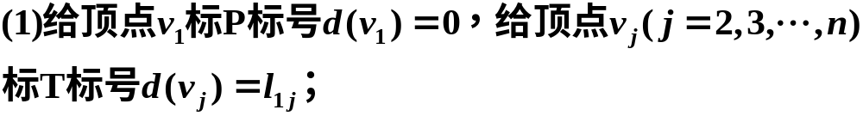
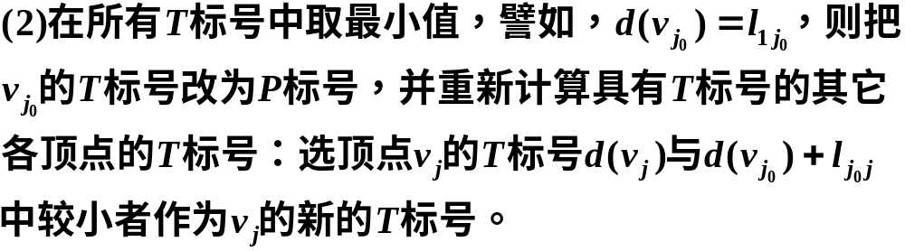
Dijkstra算法

Slide 48
v₂
1
v₅
2
v₈
2
5
9
9
6
3
7
v₁
8
1
6
2
v₃
v₆
v₉
v₁₁
2
3
1
7
4
1
4
v₄
9
v₇
1
v₁₀
3₂
---固定编号，下标表示前趋顶点
8₁
---临时编号，下标表示前趋顶点

Slide 49
v₂
1
∞
v₅
2
∞
v₈
2₁
2
5
9
7
9
6
3
8₁
1
∞
6
∞
∞
v₁
8
2
0
v₃
v₆
v₉
v₁₁
2
3
1
7
4
1
4
1₁
v₄
9
v₇
1
v₁₀
∞
∞
v₂
1
∞
v₅
2
∞
v₈
2₁
2
5
9
7
9
6
3
8₁
1
∞
6
∞
∞
v₁
8
2
0
v₃
v₆
v₉
v₁₁
2
3
1
7
4
1
4
1₁
v₄
9
v₇
1
v₁₀
10₄
∞

Slide 50
v₂
1
3₂
v₅
2
∞
v₈
2₁
2
5
9
7
9
6
3
8₁
1
∞
6
∞
∞
v₁
8
2
0
v₃
v₆
v₉
v₁₁
2
3
1
7
4
1
4
1₁
v₄
9
v₇
1
v₁₀
10₄
∞
v₂
v₅
5₅
v₈
2₁
1
3₂
2
2
5
9
7
9
6
3
8₁
1
6₅
6
12₅
∞
v₁
8
2
0
v₃
v₆
v₉
v₁₁
2
3
1
7
4
1
4
1₁
v₄
9
v₇
1
v₁₀
10₄
∞

Slide 51
v₂
v₅
5₅
v₈
2₁
1
3₂
2
2
5
9
7
9
6
3
8₁
1
6₅
6
12₅
14₈
v₁
8
2
0
v₃
v₆
v₉
v₁₁
2
3
1
7
4
1
4
1₁
v₄
9
v₇
1
v₁₀
10₄
∞
v₂
v₅
5₅
v₈
2₁
1
3₂
2
2
5
9
7
9
6
3
7₆
1
6₅
6
12₅
14₈
v₁
8
2
0
v₃
v₆
v₉
v₁₁
2
3
1
7
4
1
4
1₁
v₄
9
v₇
1
v₁₀
10₄
∞

Slide 52
v₂
v₅
5₅
v₈
2₁
1
3₂
2
2
5
9
7
9
6
3
7₆
1
6₅
6
12₅
14₈
v₁
8
2
0
v₃
v₆
v₉
v₁₁
2
3
1
7
4
1
4
1₁
v₄
9
v₇
1
v₁₀
9₃
∞
v₂
v₅
5₅
v₈
2₁
1
3₂
2
2
5
9
7
9
6
3
7₆
1
6₅
6
12₅
14₈
v₁
8
2
0
v₃
v₆
v₉
v₁₁
2
3
1
7
4
1
4
1₁
v₄
9
v₇
1
v₁₀
9₃
10₇

Slide 53
v₂
v₅
5₅
v₈
2₁
1
3₂
2
2
5
9
7
9
6
3
7₆
1
6₅
6
11₁₀
14₈
v₁
8
2
0
v₃
v₆
v₉
v₁₁
2
3
1
7
4
1
4
1₁
v₄
9
v₇
1
v₁₀
9₃
10₇
v₂
v₅
5₅
v₈
2₁
1
3₂
2
2
5
9
7
9
6
3
7₆
1
6₅
6
11₁₀
13₉
v₁
8
2
0
v₃
v₆
v₉
v₁₁
2
3
1
7
4
1
4
1₁
v₄
9
v₇
1
v₁₀
9₃
10₇

Slide 54
v₂
v₅
5₅
v₈
2₁
1
3₂
2
2
5
9
7
9
6
3
7₆
1
6₅
6
11₁₀
13₉
v₁
8
2
0
v₃
v₆
v₉
v₁₁
2
3
1
7
4
1
4
1₁
v₄
9
v₇
1
v₁₀
9₃
10₇
v₂
v₅
5₅
v₈
2₁
1
3₂
2
2
5
9
7
9
6
3
7₆
1
6₅
6
11₁₀
13₉
v₁
8
2
0
v₃
v₆
v₉
v₁₁
2
3
1
7
4
1
4
1₁
v₄
9
v₇
1
v₁₀
9₃
10₇

Slide 55
解最短路问题的基本方法--Dijkstra算法
把以顶点及其前趋顶点作为端点的边作为一个集合，该边集导出的子图是一个生成树。
v₂
v₅
5₅
v₈
2₁
1
3₂
2
2
3
7₆
1
6₅
11₁₀
13₉
v₁
2
0
v₃
v₆
v₉
v₁₁
2
1
1
1₁
v₄
v₇
1
v₁₀
9₃
10₇
该生成树是否是最小生成树？

Slide 56
#include <iostream>
using namespace std;
int map[110][110];//存放邻接矩阵
#define INF 10000000 //表示无穷
int main()
{
int n,m;
while (1)
{
scanf("%d%d",&n,&m);
if (n==0&&m==0) break;
for (int ct0=0;ct0<110;ct0++)
{
for (int ct1=0;ct1<110;ct1++)
{
map[ct0][ct1]=INF;
}
}//全标为∞

Slide 57
for (int ct0=0;ct0<m;ct0++)
{
int a,b,c;
scanf("%d%d%d",&a,&b,&c);
a--;//对应到数组下标应减一
b--;
map[a][b]=map[b][a]=c;//为对称的邻接矩阵赋权值
}
int dis[110];//存放从商店出发至各路口的最短路
bool f[110];//标记是否被访问
for (int ct0=0;ct0<110;ct0++)
{
dis[ct0]=INF;//初始为无穷远
f[ct0]=0;//表示未被访问的路口
}
dis[0]=0;
for (int ct0=0;ct0<n;ct0++)
{
int minp=-1;
int mind=INF;

Slide 58
for (int ct1=0;ct1<n;ct1++)
{
if (f[ct1]==0 && dis[ct1]<mind)
{
mind=dis[ct1];//寻找邻接边中权值最小的
minp=ct1;//标记这条边所对应的路口
}
}
if (minp==-1)
break;//若未找到能走下去的路则结束
if (minp==n-1)
break;//若已走到赛场则结束
f[minp]=1;//表示已找到至某一个路口的最短路

Slide 59
for (int ct1=0;ct1<n;ct1++)
{
if (f[ct1]==0 && mind+map[minp][ct1]<dis[ct1])
{
dis[ct1]=mind+map[minp][ct1];//从已找到的具有最
//短路的路口出发,至下一路口，是否比原线路更短
}
}
}
if (dis[n-1]>=INF)//至赛场的距离为无穷
printf("Impossible\n");
else
printf("%d\n",dis[n-1]);
}
return 0;
}

